Slide 1
EFFECTIVE GTA TRAINING
Kathy Nomme, Professor of Teaching Emerita, Departments of Botany and Zoology, University of British Columbia
Carol Pollock, Professor of Teaching Emerita, Department of Zoology, University of British Columbia
BioTAP Conference October 21, 2025
Notes:
KN 2 min Introduction: Thank you to organizers for inviting us, We introduce ourselves,
CP 3 min land acknowledgement: No matter where we are at this moment, we acknowledge that we are sharing the traditional lands with the first nations that lived here before us. We are thankful for the opportunity to work, study and learn on these lands.

Slide 2
Expectations
What are your expectations for this workshop?
Notes:
CP Type in the chat. Acknowledge expectations and we will attempt to address most

Slide 3
Learning Outcomes:
By the end of this workshop you should be able to:
Identify essential components of a GTA training program
and possible ways to implement them.
Determine potential challenges in implementing GTA training sessions and how to address them.
Identify ways of evaluating a GTA training program and types of educational research.
Notes:
CP Review these

Slide 4
What topics are essential in a GTA training program?
Your ideas:
Google Doc for Keynote activities: https://docs.google.com/document/d/1uwGhcLiWxTNwY7U4F5_s9M1Nn4QjAmy1YkBSwqAZOUc/edit?tab=t.0
Notes:
CP 5 min Recognizing that GTA training is important. Discuss as one large group. Scribe onto slide or a Google doc that will be shared in each room. Add other items from the Stat paper if missed.

Slide 5
What topics are essential in a GTA training program?
In assigned groups you will choose one topic.
Describe how you could incorporate it into a GTA training session.
What issues could arise?
How would you address these issues?
Notes:
CP 2 min Give an overview of the activity. Choose a topic from the list, think of ways to implement the topic, what issues might arise, and how would you deal with these.

Slide 6
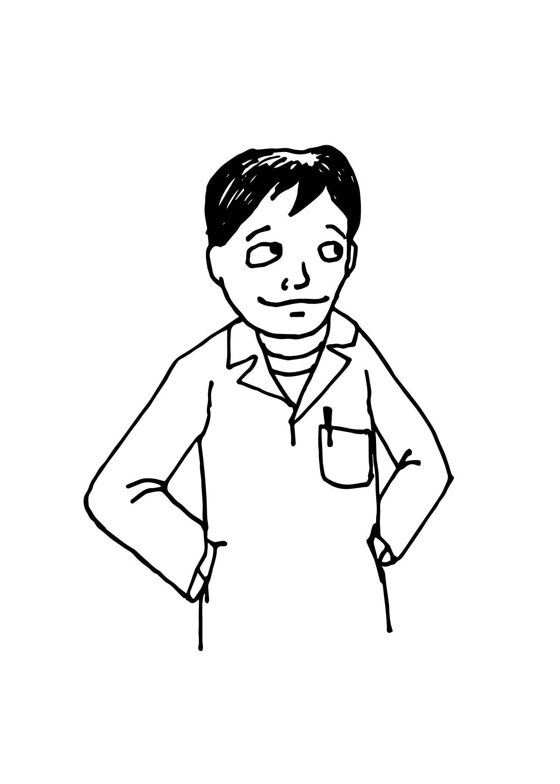
Implementing an essential topic in GTA training
An example topic: First time GTA nervousness and lack of confidence.
Implement by introducing the scenario for discussion.
A GTA is very nervous about the first lab they will be teaching. They have practiced their introduction several times but each time they feel more anxious about what to say as well as how the whole lab will go.
Notes:
CP 2 min. As an example: We used a scenario for discussion - perhaps describe how this was effective..

Slide 7
Implementing an essential topic in GTA training
An example topic: First time GTA nervousness and lack of confidence.
Incorporate by introducing the scenario for discussion at a preparation session.
Issues: First-time GTAs may be reluctant to admit to nervousness and/or take advice.
How to address issues: Set up team-teaching for first session, offer to be audience for a practice run, . . .
Notes:
CP 3 min. Other ways to overcome reluctance: Encourage experienced TA’s in the course to act as mentors and provide tips, arrange for new GTAs to observe experienced TAs before they teach their own class.
Anxiety can be OK if you are well prepared, you may just be excited! Meeting new students at the beginning of a course can be invigorating.

Slide 8

In your break-out groups:
Choose a group facilitator and a scribe.
From the list we generated choose a topic.
Discuss ways to include the topic in a GTA training session.
Identify issues that might arise and how you would address these issues.
Note your ideas on your group’s page in the Google doc.
Choose one person to present your ideas (max 2 minutes) to the whole group.
Notes:
CP 3 min. review instructions 15 min. to discuss. Choose a group facilitator we suggest whose first name is first in the alphabet (pass to the next person if necessary), a scribe, and a presenter.

Slide 9
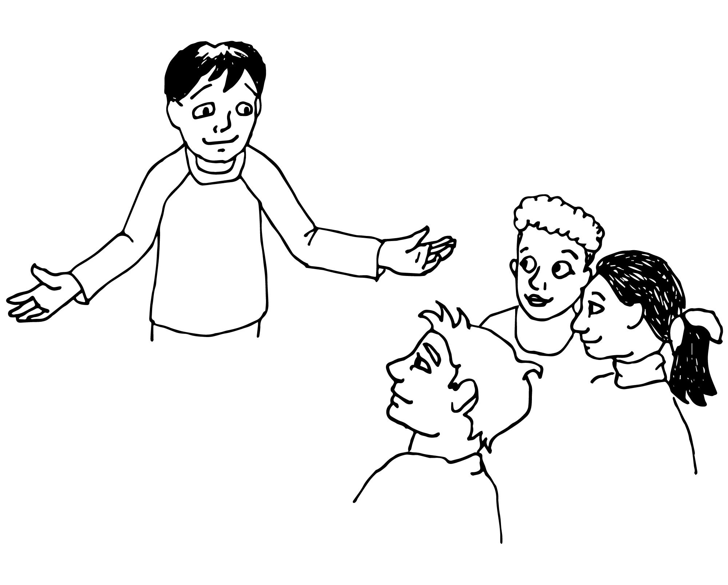
Presentations
Notes:
KN 30 min Call in, have groups present. If your ideas have already been presented, add only new ideas.

Slide 10
How can we evaluate the effectiveness of program elements?
Share your ideas by typing into the chat.
Notes:
CP 10 min Share examples if not mentioned: observation of TAs in action, feedback from students and others (supervisors, instructors), GTA focus groups, survey GTAs (copy chat onto slide or other doc to be retrieved later)

Slide 11
Devising research to provide evidence of impact
Notes:
KN 10 min Evidence often needed to justify programs. Anecdotal evidence is useful, but research, especially if published in a peer reviewed journal provides further support for your efforts.
If there is time, ask what form education research takes and what elements are necessary. Ask if any in the audience have already contributed to the literature.

Slide 12
Devising research to provide evidence of impact
Meta analysis of literature
across disciplines, institutions, countries
Notes:
KN Review

Slide 13
Devising research to provide evidence of impact
Meta analysis of literature
across disciplines, institutions, countries
Qualitative vs quantitative research
Descriptive, interviews,focus groups, observations
Content, thematic and narrative analysis
Notes:
KN Review

Slide 14
Devising research to provide evidence of impact
Meta analysis of literature
across disciplines, institutions, countries
Qualitative vs quantitative research
Descriptive, interviews,focus groups, observations
Content, thematic and narrative analysis
Quantitative studies capture data
Use surveys, numerical observation techniques
Implement treatments, randomization, controls
Notes:
KN Review

Slide 15
Devising research to provide evidence of impact
Meta analysis of literature
across disciplines, institutions, countries
Qualitative vs quantitative research
Descriptive, interviews,focus groups, observations
Content, thematic and narrative analysis
Quantitative studies capture data
Use surveys, numerical observation techniques
Implement treatments, randomization, controls
All education-related research requires ethics approval and strict adherence to privacy protocols.
Notes:
KN Review

Slide 16
Examples of research on TA Training
Mewis, K., Dee, J., Lam, V., Obradovich, S., & Cassidy. A. (2018). A new self-assessment teaching assistant survey for growth and development. Teaching & Learning Inquiry, 6(1). http://dx.doi.org/10.20343/teachlearninqu.6.1.8
Sadera, E., Suonio, E. E. K., Chen, J. C. C., Herbert, R., Hsu, D., Bogdan, B., & Kool, B. (2024). Strategies and approaches for delivering sustainable training and professional development of graduate teaching assistants, teaching assistants, and tutors: A scoping review. Journal of Applied Research in Higher Education, 16(5), 2199-2215. https://doi.org/10.1108/JARHE-08-2023-0323
Notes:
KN Briefly review each : Mewis - developed survey quantitative data collection
Sadera - qualitative data from interviews. Both formats provide valuable insights into different strategies and their effectiveness.
We have provided other references at the end of the PPT that may be helpful.

Slide 17
Our Learning Outcomes:
By the end of this workshop you should be able to:
Identify essential components of a GTA training program
and possible ways to implement them.
Determine potential challenges in implementing GTA training sessions and how to address them.
Identify ways of evaluating a GTA training program and types of educational research.
Notes:
KN 5 min Review these. Our message is that TA training is valuable, It is important to measure effectiveness - to identify areas needing improvement, research provides evidence for future funding and further program development.

Slide 18
Your take home ideas
Notes:
KN Ask them to consider their main take-aways.

Slide 19
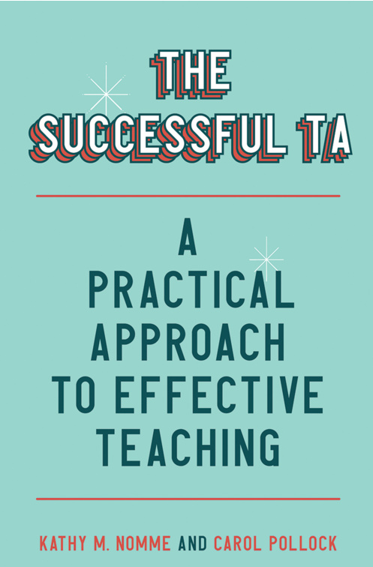
Thank you for your interest, participation and caring about TA training
To carry on the conversation
or for more information contact:
Carol Pollock pollock@zoology.ubc.ca
Kathy Nomme nomme@zoology.ubc.ca
Notes:
KN We also thank all the GTAs we have encountered over the years of our work in BioTAP at UBC

Slide 20
Additional References
Justice, N. (2020). Preparing Graduate Students to Teach Statistics: A Review of Research and Ten Practical Recommendations. Journal of Statistics Education, 28(3), 334–343. https://doi.org/10.1080/10691898.2020.1841590
Knezz, S., Berns, V., Schwabacher, J., Coleman, A. 2024. Graduate Student Leadership in a TA Training Program. Journal of Chemical Education. DOI:10.1021/acs.jchemed.3c00969
McLeod, C. L., Almquist, C. B., Ess, M. P., Zhang, J., Schultz, H., Nguyen, T., Tran, K., & Hughes, M. (2025). Graduate Teaching Assistants (GTAs): Roles, Perspectives, and Prioritizing GTA Workforce Development Pathways. Education Sciences, 15(7), 838. https://doi.org/10.3390/educsci15070838
Mewis, K., Dee, J., Lam, V., Obradovich, S., & Cassidy. A. (2018). A new self-assessment teaching assistant survey for growth and development. Teaching & Learning Inquiry, 6(1). http://dx.doi.org/10.20343/teachlearninqu.6.1.8
Notes:
additional references - just a few recent ones, show some of the current areas of research will be available with the the posted slides.

Slide 21
Additional References (continued)
Nomme, K., and Pollock, C. (2022). The Successful TA. A Practical Approach to Effective Teaching. UBC Press. https://www.ubcpress.ca/the-successful-ta
Sadera, E., Suonio, E. E. K., Chen, J. C. C., Herbert, R., Hsu, D., Bogdan, B., & Kool, B. (2024). Strategies and approaches for delivering sustainable training and professional development of graduate teaching assistants, teaching assistants, and tutors: A scoping review. Journal of Applied Research in Higher Education, 16(5), 2199-2215. https://doi.org/10.1108/JARHE-08-2023-0323
Westwood, N.E., Srivastava, D.S. (2025). Perspectives of graduate student teaching assistants on value and meaning in their role. Journal of Microbiology and Biology Education. 0:e00115-25. https://doi.org/10.1128/jmbe.00115-25

